Slide 1
Lakers Road to the Playoffs
By: Michelle Arriaga, Cory Nichols, and adam soto
Southern Methodist university
Masters of data science program

Slide 2
Project Background
Project was inspired by the Moneyball concept.
2002, the Oakland A’s head coach Billy Beane used On Base Percentage and Slugging Percentage as player selection indicators.
By identifying key variables that were highly correlated to wins, Beane’s strategy of player selection lead to a successful 2002 season for the Oakland A’s.

Slide 3
Problem:
The Los Angeles Lakers used to be a dominant force in the Western Conference of the NBA. During the span of the last 3-5 years, the Lakers have lost their competitive edge and have not been a playoff contender.
Goal:
Using the moneyball concept, how can the Lakers increase their chances of the Lakers making it to the Western Conference Playoffs.
Build a dynamic prediction tool, based on the highly influential, highly correlated variables that lead to wins.

Slide 4
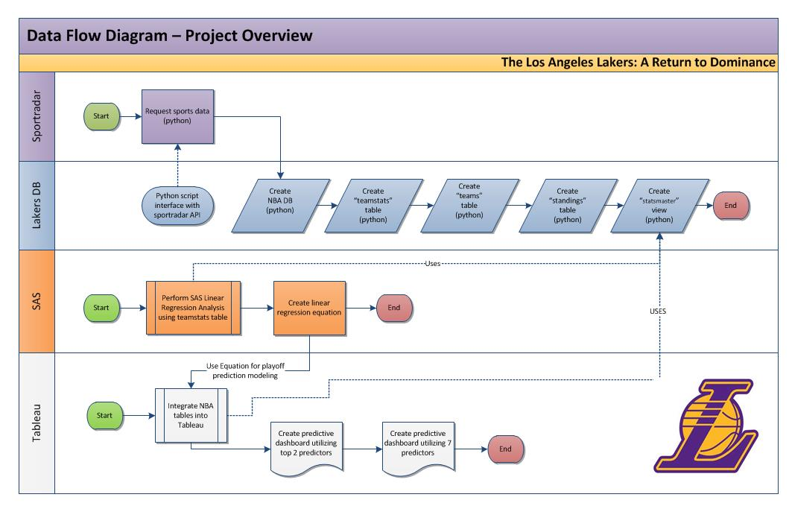
Data Flow Process:

Slide 5


Data Flow Process:
SportRadar API:
Used to retrieve 4 yrs worth of NBA statistics
Lakers Database:
Used a MySQL database to store the NBA Team data
Tables:
Teams (conference details)
Standings (season wins/losses)
Team Stats
View:
Statsmaster

Slide 6


Data Flow Process:
Python:
Using the Pandas Library for Python, we were able to:
Retrieve the NBA Statistics from the API
Format the data in Json
Build a Dataframe
Insert the data into MySQL

Slide 7

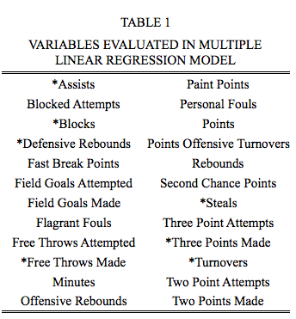
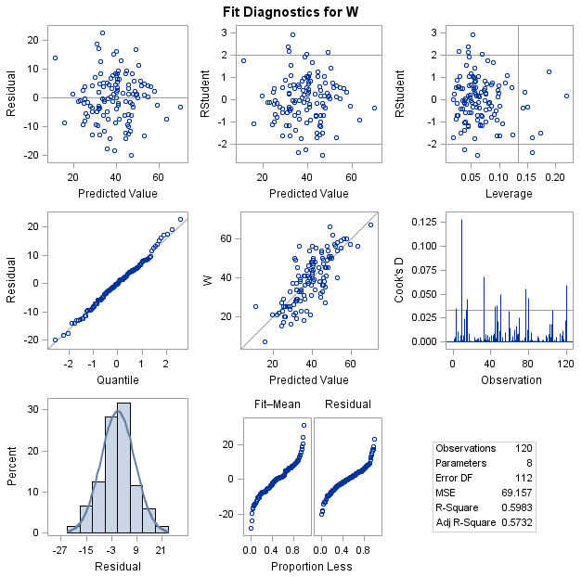
Data Flow Process:
SAS:
Performed a Multiple Linear Regression Statistical Analysis
Evaluated 24 individual variables and determined that 7 were highly correlated with wins
Built a prediction model

Slide 8
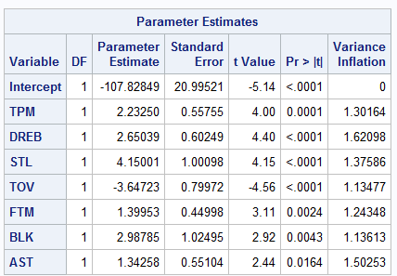
Prediction Equation:
Overall Wins = -107.83 + (2.23*TPM) + (2.65*DREB) + (4.15*STL)
+ (-3.65*TOV) + (1.4*FTM) + (2.99*BLK) + (1.34*AST)

Slide 9

Data Flow Process:
Tableau:
Used to report our findings
Used to build an interactive model for the user
Link to Tableau Dashboard

